Slide 1
Study and Research at TUM
Sören Metz, Senior Regional Manager (Latin America)
September 2024

Slide 2
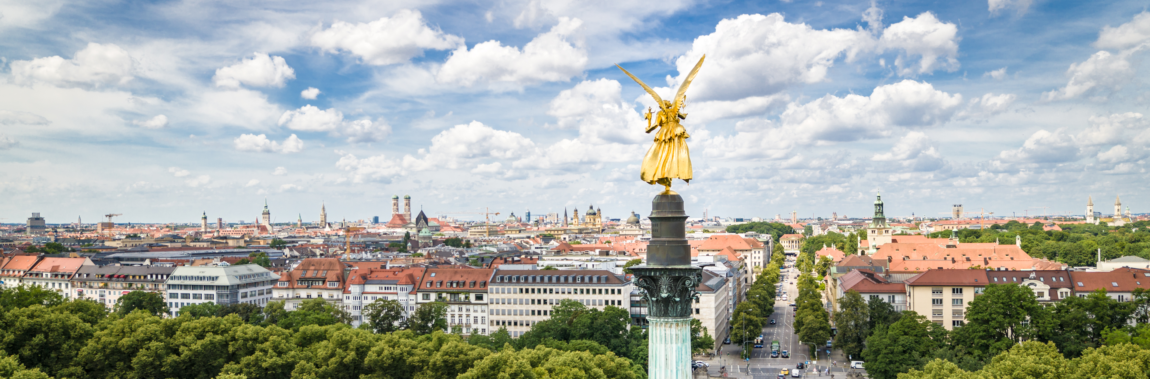
Munich – Why?
Our historical home site in Munich’s Maxvorstadt district, between Königsplatz and the Pinakotheken art museums, is surrounded by research institutions and home to several schools and departments.
Source: ProLehre Medienredaktion

Slide 3
TUM Facts and Figures
(Statistics 2021)
36% Female Students
38% International Students
7 Schools
more than 9,500 Graduates per year
50,000 students (Bsc / MSc)
623 Professors
155 ERC Grants (since 2008)

Slide 4
A Leader in Academic Rankings
QS World University Rankings 2024
No. 1 in Germany
No. 28 in the world
THE World University Rankings 2024
No. 1 in Germany
No. 30 in the world
Shanghai World University Ranking 2024
No. 2 in Germany
No. 59 in the world
Notes:
Not competition, but collaboration will contribute to meeto solve today‘s global challenges of the future.
Only together we will be able to solve them.

Slide 5
TUM Schools. Departments
Computation, Information & Technology*
Engineering
& Design
Natural Sciences
Life
Sciences
Medicine & Health
Management*
Social
Sciences &Technology
Aerospace
& Geodesy
Mathematics
Architecture
Physics
Molecular Life Sciences
Prevention
Innovation & Entrepreneurship
Politics & Technology
Computer
Science
Civil & Environmental Engineering
Bioscience & BioEngineering
Life Science Engineering
Theoretical Medicine
Marketing, Strategy & Leadership
Science & Technology Studies
Computer Engineering
Engineering Physics
& Computation
Chemistry
Life Science Systems
Clinical Medicine
Operations & Supply Chain Management
Education
Electrical Engineering
Mobility Systems Engineering
Digital Health
& Technology
Finance
& Accounting
Mechanical Engineering
Economics
& Policy
Materials
Engineering
Energy & Process Engineering
* joint research & education activities
on TUM Campus Heilbronn

Slide 6
Converging Science
TUM Matrix. Systems Integration.
Biomedical Engineering
Robotics and Machine Intelligence
Materials, Energy and Process Engineering
Data Science
Biotechnology and Sustainability
INTEGRATED RESEARCH INSTITUTES
TUM SCHOOLS
Medicine and Health
Natural Sciences
Computation, Information and Technology
Engineering and Design
Social Sciences and Technology
Management
Life Sciences
Notes:
44% international bei Studienanfängern

Slide 7
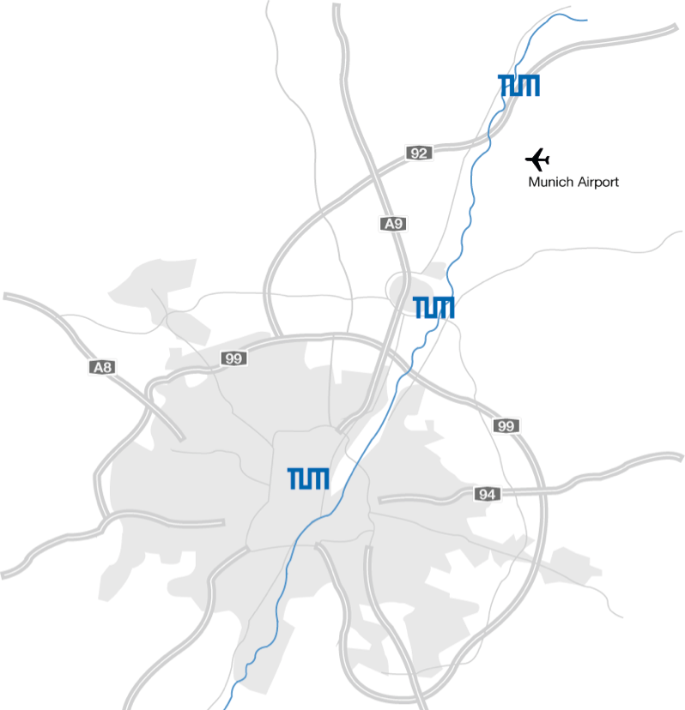
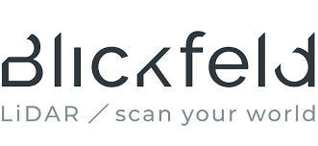
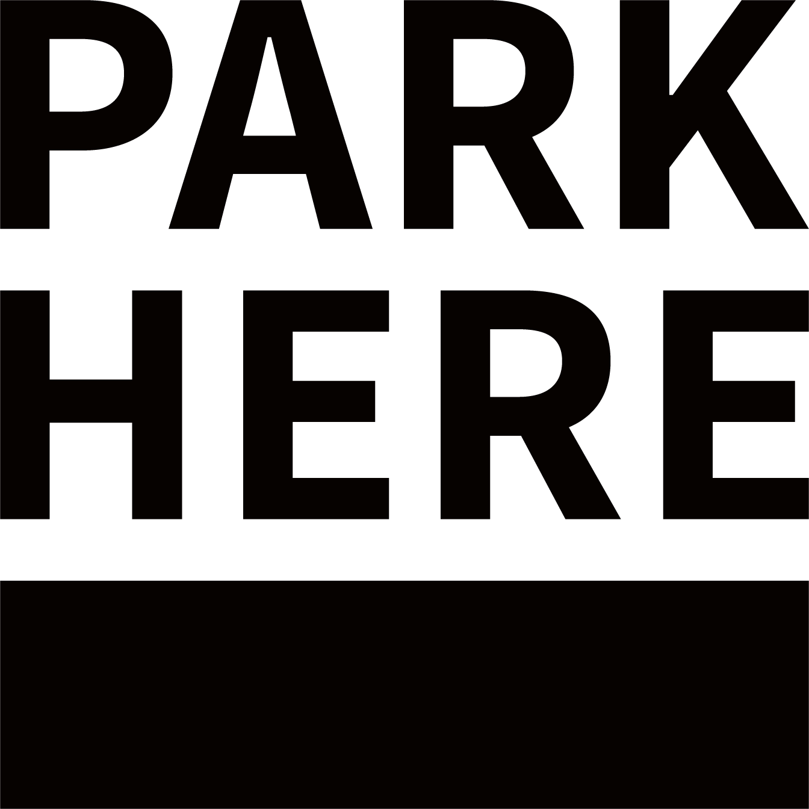
ONE MUNICH. European Innovation Hub
Academic Network
Industry Network
Start-up Network
Start-ups p.a. vs. 2001
TUM Joint
Appointments
51
+450%

Slide 8
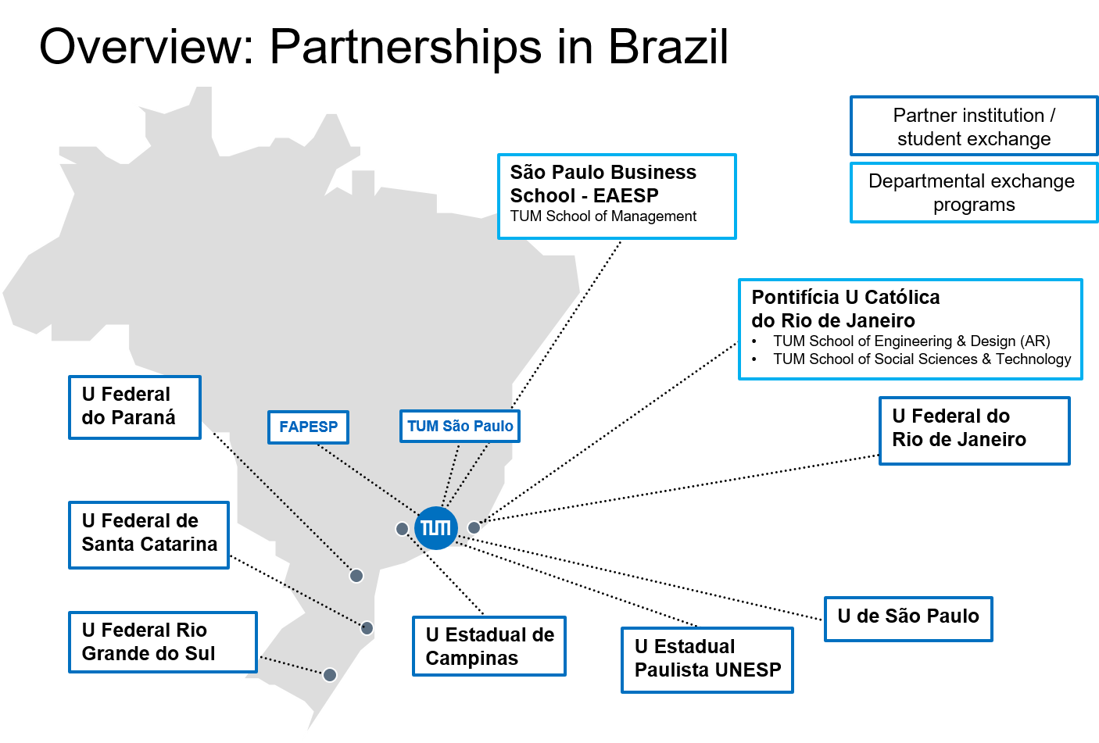
TUM and Brazil
7 partner institutions; 3 departmental partnerships Brazil is by far TUM’s strongest research partner in Latin America A total of 982 joint publications; 350 (max. authorship = 10) Over 20 TUM Global Incentive Fund projects (2016 – 22) 210 Brazilian degree-seeking students (WS 2022/23)

Slide 9
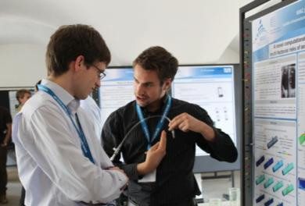
Master courses at TUM 1/2
Various Master courses completely in English or in English/German
30 Master courses in English and 28 Master courses in English and German in Science and Engineering
http://portal.mytum.de/studium/studiengaenge/englisch
Duration
2 years (4 semesters)
Administrative Fees: 117 Euros / semester
Tuition fees: 4000 - 6000 euros / semester (Non EU-countries)
Scholarships available!
Preconditions / Application process
Outstanding Bachelor degree (BSc), needs to be recognized
Letter of Motivation
Letters of recommendation (normally from 2 different professors)
German language skills helpful but not mandatory (only for Master courses completely in English language)
Good knowledge of English is essential (TOEFL: min IbT:88, CbT:234, PbT: 605 / IELTS: min 6,5 and CAE&CPE Level A,B and C )
Sometimes Internships and work experience required
Interviews in some cases (via skype or personally)
Every course has its own list of required documents

Slide 10
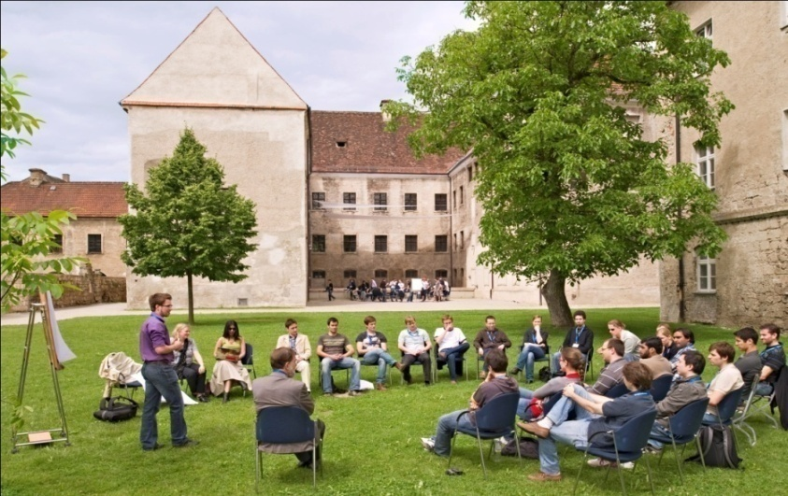
Master courses at TUM 2/2
International Master courses in English (examples)
Aerospace (Master)
Agricultural Biosciences (Master)
Bioeconomy (Master)
Sustainable Resource Management (Master)
Nutrition and Biomedicine (Master)
Physics (Applied and Engineering Physics) (Master)
Power Engineering (Master)
Environmental Engineering (Master)
Communications Engineering (Master)
Management and Technology (TUM-BWL) (Master)
Transportation Systems (Master)

Slide 11
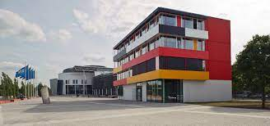
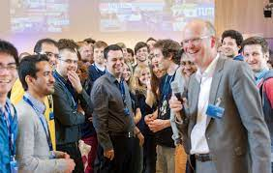
Application for a doctorate at TUM
Pre-requisites
Excellent Master’s degree
a foreign Master’s degree following a subject-related Bachelor’s degree with a time-frame of 1-2 years, completed with an examination and an independent academic thesis
final decision & possible conditions set by the dean’s office
Fluency in English (German not needed but a plus; depends on the research group)
Funding
No TUITION Fees
A TUM professor who supervises the doctoral research

Slide 12
Application for a doctorate at TUM
Application procedure
Supervisor – search/ contact
- pitfalls to avoid
- how to stand out
→ Application for the entry into the doctoral candidacy list

Slide 13
TUM Global Postdoc Fellowship
Apply for the two-year fellowship to conduct your own project together with TUM researchers
Prestigious two-year fellowship: Conduct your own project together with a TUM chair
Program with workshops & funding support to extend your stay at TUM
Fellowship amount € 3020 per month + benefits for families
Who can apply?
External international postdocs & German researchers working abroad
Researchers in Germany at institutions other than TUM
Postdocs (PhD obtained within the last 3 years) & final-year doctoral candidates
Application documents
Four page research proposal & letter of support from a TUM host
2 calls per year
Website: http://www.tum.de/global-postdoc
Find out more about the current fellows: https://www.forte.tum.de/en/tuff/

Slide 14
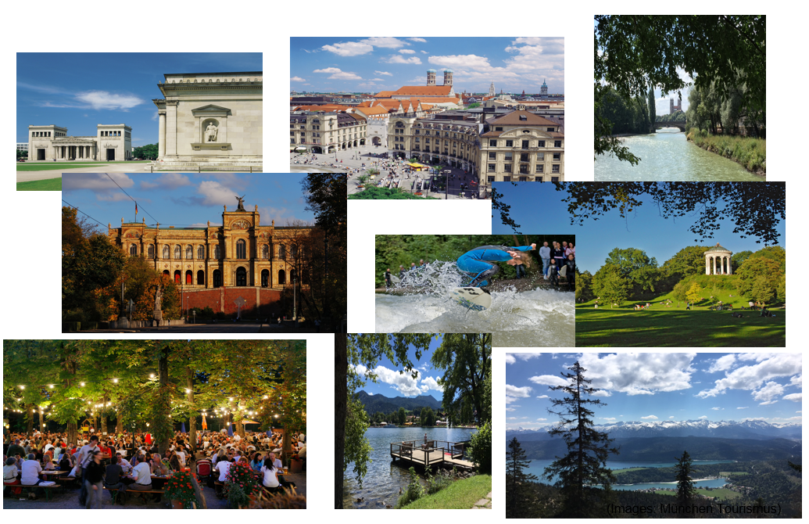
Impressions from Munich
(Images: München Tourismus)

Slide 15
TUM Sao Paulo – Liaison Office for Latin America
Contact:
Sören Artur Metz
Senior Regional Manager (Latin America)
Liaison Officer TUM São Paulo
Rua Verbo Divino, 1488, Térreo
04719-904 São Paulo – SP / Brazil
TUM São Paulo LinkedIn
Please connect & follow us:
https://www.linkedin.com/showcase/tum-são-paulo/
Phone: +55 (11) 5189 8320
Email: saopaulo@tum.de
Website: www.saopaulo.tum.de

