Slide 1

The German Centre for Research and Innovation (DWIH) São Paulo
& German Funding Programmes
Germany Day,
Unicamp Limeira, September 10th, 2024

Slide 2
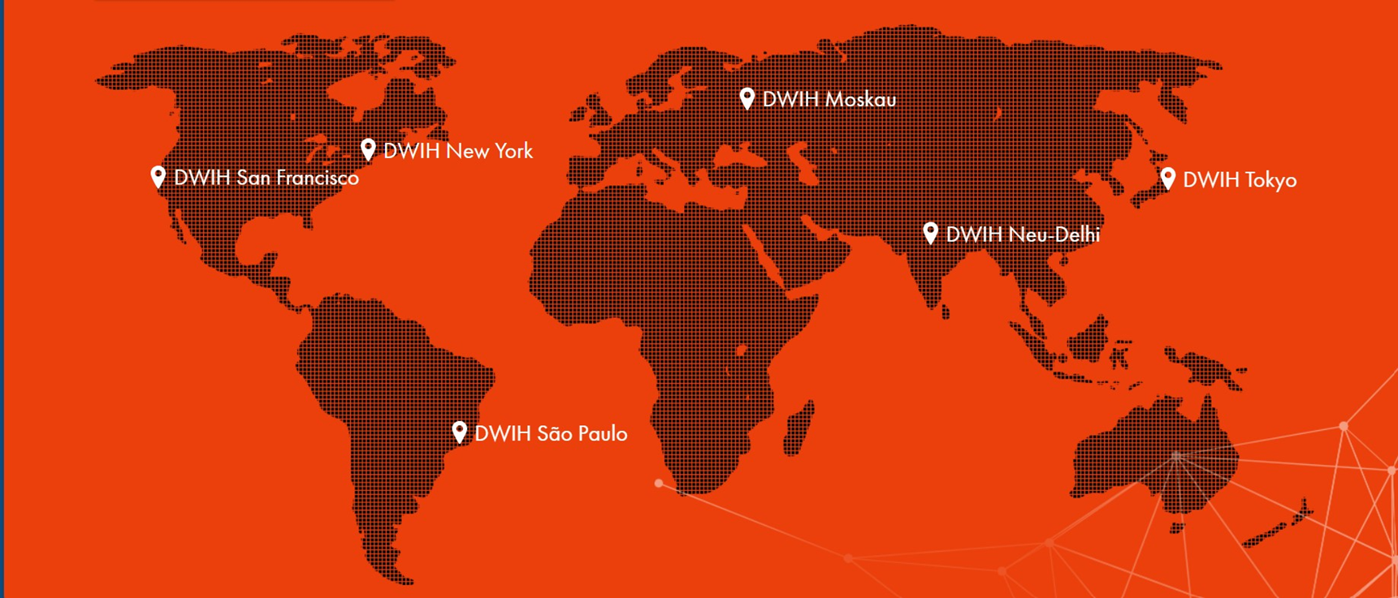
DWIH Network
6 innovation forums at 6 prominent locations around the world
A joint initiative led by politics, business and science
Around 100 supporters worldwide
Management and general responsibility held by the DAAD in Bonn

Slide 3

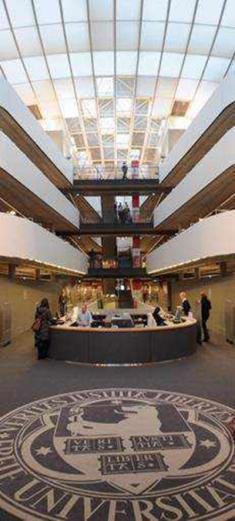

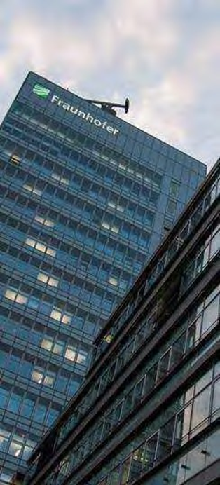



Supporters
3 Funding
Organizations
16 Universities
2 HEI Alliances
4 Non-University Research Associations
2 State Level
Representations
2 Other organizations for specific purposes

Slide 4





























Supporters
Full Supporters
Associated Supporters

Slide 5
Objectives
Knowledge
Networking
Advice
Visibility
￭ Insider information about the R&I landscape
￭ Targeted public relations work
￭ Bi-directional knowledge transfer approach
￭ Networking of innovation leaders
￭ Strategic partner commitment
￭ Access to networks
￭ One-stop-shop for first-hand information
￭ Access to media channels and other services
￭ Customised services
￭ Together under one roof
￭ Value added to individual activities
￭ Bundling of:
￭ information
￭ contacts
￭ competences
￭ Continuity

Slide 6
Activities
Scientific Cooperation
Science-Business Interface
Research-based Entrepreneurship
Study, Research and Innovate in/with Germany

Slide 7
Special Topics 2024
Human- and Society-Focused Artificial Intelligence
200-years Jubilee
of German Immigration
in Brazil

Slide 8
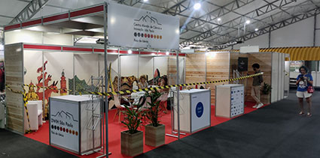
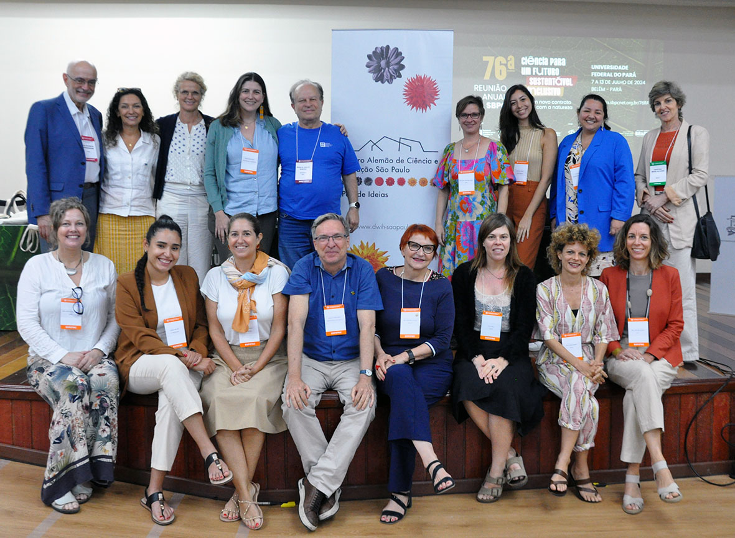
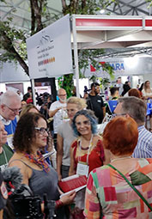


76th Annual Meeting of the Brazilian Society for the Advancement of Science (SBPC)
DWIH São Paulo: Highlights 2024
Belém
7th-13th July
Round Table
“The attractiveness of a scientific career in Brazil for foreign researchers”

Slide 9
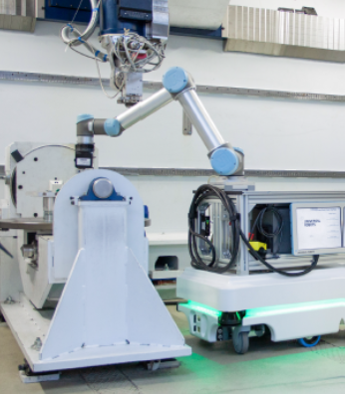



International Industry Workshop on
Machine Vision and Robotics
DWIH São Paulo: Highlights 2024
São José dos Campos
25th June
Workshop with participants from academy, companies and other innovation actors

Slide 10





AI20: Debating Artificial Intelligence in a Global Context, an Interdisciplinary Conference on AI for the G20 Summit 2024
DWIH São Paulo: Highlights 2024
Rio de Janeiro
18th-19th July
Open Conference
Work groups
Policy paper for G20

Slide 11
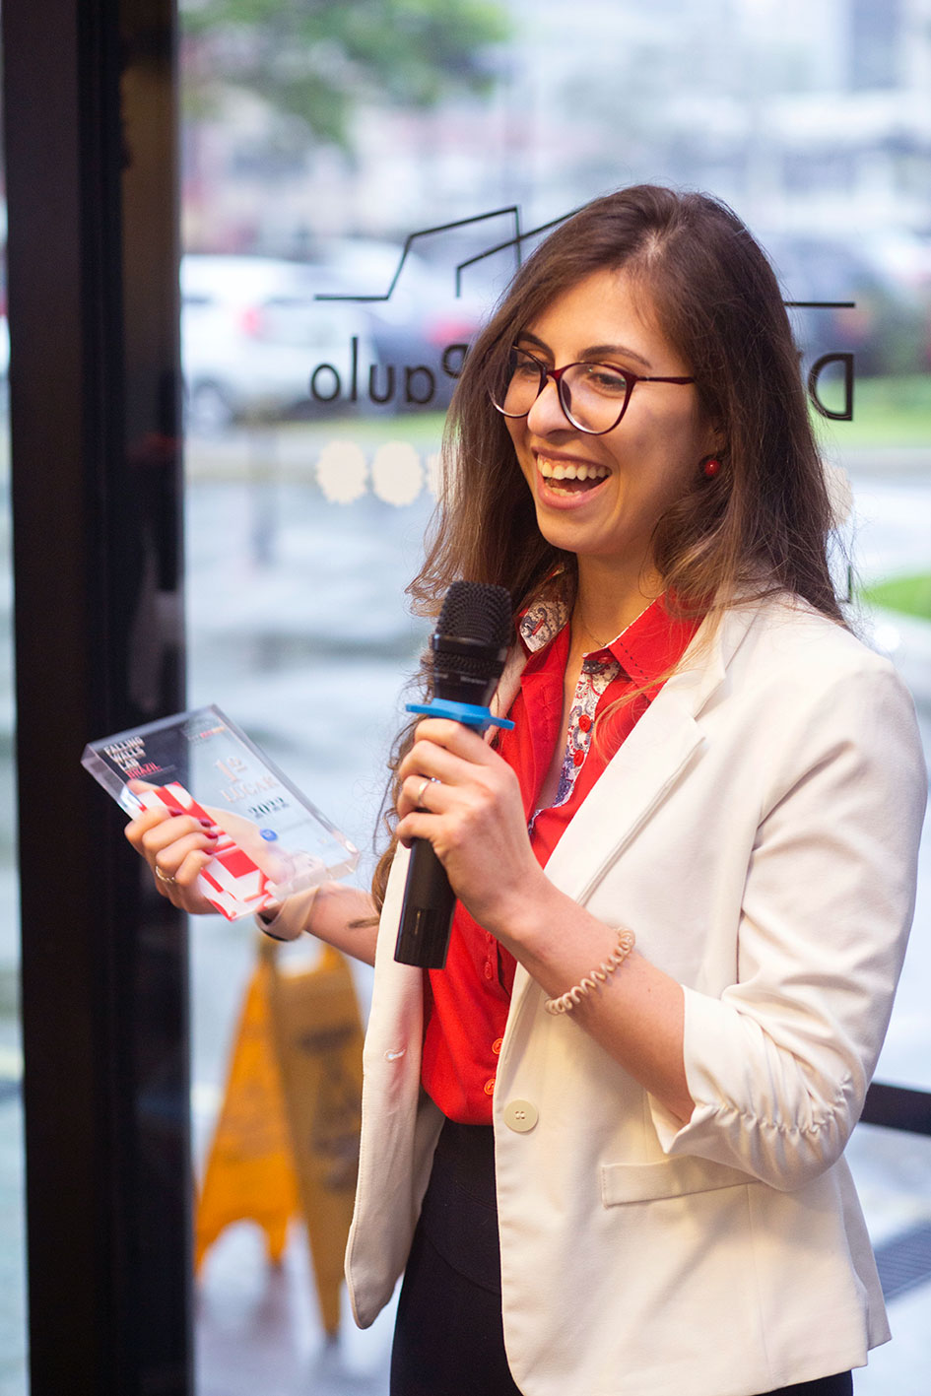



Falling Walls Lab Brazil
DWIH São Paulo: Next Events 2024
Recife
27th September
CESAR School
15 Finalists
2 winners will represent Brazil in the final round in Berlin
2022: Winner PhD Student Isabella Rodrigues, Unicamp Limeira

Slide 12




Symposium
“Care that Matters, Matters of Care:
Overcoming Inequalities through Care Policies”
DWIH São Paulo: Highlights 2024
São Paulo
14th-15th October
Side event of the T20
Researchers, civil society actors and government representatives working on care policies as key tools to address gender inequalities and their intersections with class and ethnic discrimination

Slide 13


11th German-Brazilian Dialogue on Science, Research and Innovation: “Artificial Intelligence:
Focus on People and Society”
DWIH São Paulo: Save the Date 2025
São Paulo,
7th - 8th May
Keynotes
Panels
Approx. 16-20 Invited Speakers
Session “Funding Programmes”

Slide 14

German Funding Programmes
German Research Foundation
Sociedade Alemã de Amparo à Pesquisa

Slide 15


German Funding Programmes
FAPESP: Funding of workshops and mobility; joint individual projects; Funding of Coordinated Programmes: International Research Training Groups, Research Units, Collaborative Research Centers
Submissions possible at any time
Cooperation | Funding | Duration
No or few contact with foreign partner | Initiation of International Cooperation Preparatory and cooperative visits, bilateral events such as workshops, etc. | up to 3 m. within 12 m.
 | Bilateral collaborative projects Personnel, instrumentation, consumables, travel budget, guest scientists, budget for publication on the German side for up to 3 years (renewable), module: Mercator | up to 3 year (renewable)
 | International Research Training Groups Research Units Collaborative Research Centers | 5 + 4 years 2 x 3 years 3 x 4 years
Excellent cooperation with a group of foreign partners for several years

Slide 16

German Funding Programmes
Walter-Benjamin Programm
Funding for two years
Abroad (fellowship) or in Germany (own position)
Allowance for direct project costs
Application: An acceptance letter from a university is necessary.
Further Information:
www.dfg.de/en/research-funding/funding-opportunities/programmes/individual/walter-benjamin

Slide 17
German Funding Programmes
Temporary position for principal investigators in Germany
Funding for three years
Salaried position
Project funds for: instrumentation; personnel; travel costs etc.
Application: An acceptance letter from a university is necessary.
Further Information:
https://www.dfg.de/de/formulare-50-02-246732

Slide 18

German Funding Programmes
Alexander von Humboldt Foundation
Fundação Alexander von Humboldt

Slide 19
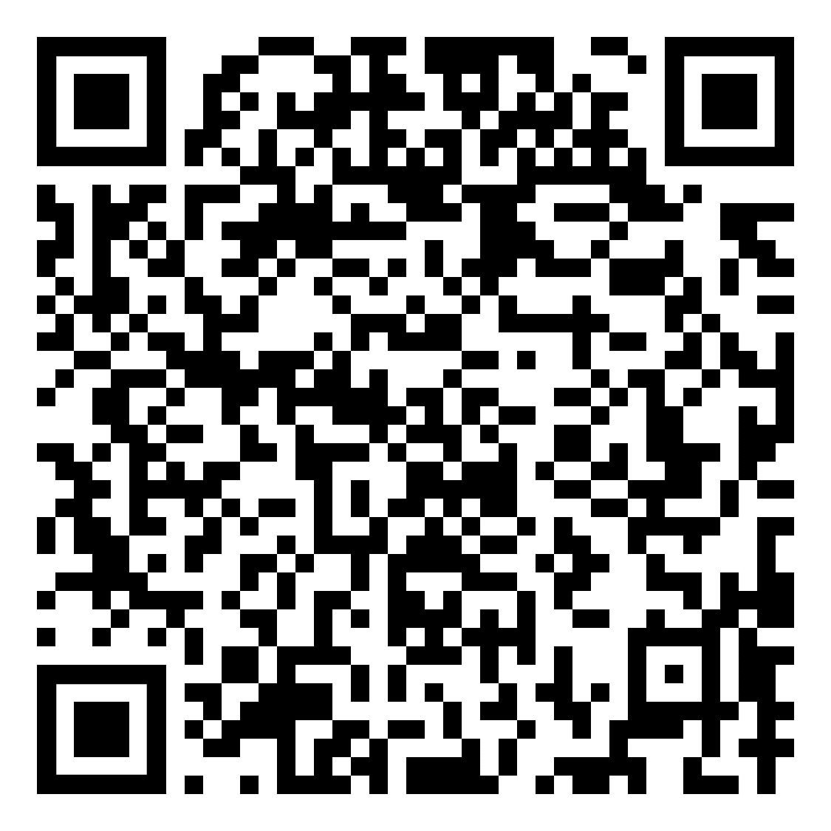

German Funding Programmes
CAPES-Humboldt Research Fellowship:
research stay of 18-24 months
info@avh.de
X: AvHStiftung
YouTube: AvHStiftung
for Postdoctoral (up to 4 years after doctorate) and Experienced Researchers (up to 12 years after doctorate)
“Sponsorship of people, not of projects”
2 calls per year (May, November)
Next deadline: November 30th, 2024
humboldt-foundation.de

Slide 20
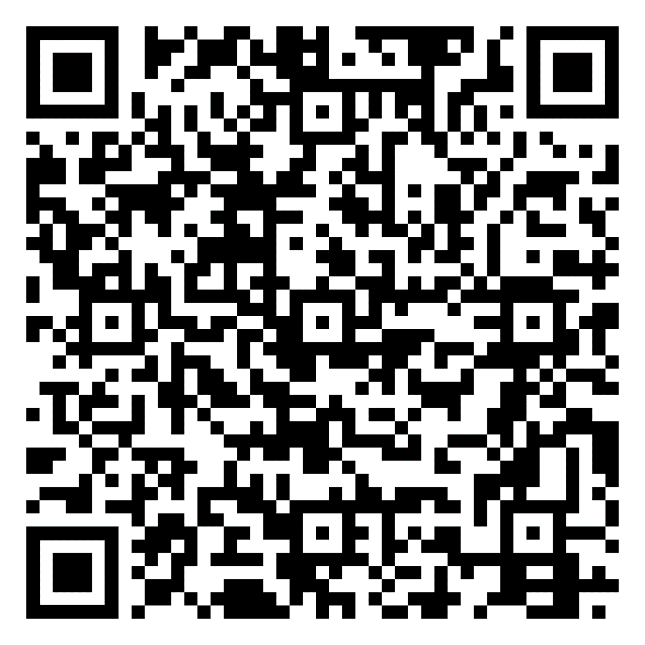
German Funding Programmes
International Climate Protection Fellowship
Project of 12-24 months in Germany
info@avh.de
X: AvHStiftung
YouTube: AvHStiftung
for prospective leaders from transition and developing countries who are engaged in climate protection (up to 12 years after first university degree)
with a background in non-governmental organisations, public administration, politics, academia, or business
Last deadline: February 1st, 2025
humboldt-foundation.de

Slide 21

German Funding Programmes
Bavarian Center for Latin America
Centro Universitário da Baviera para América Latina

Slide 22
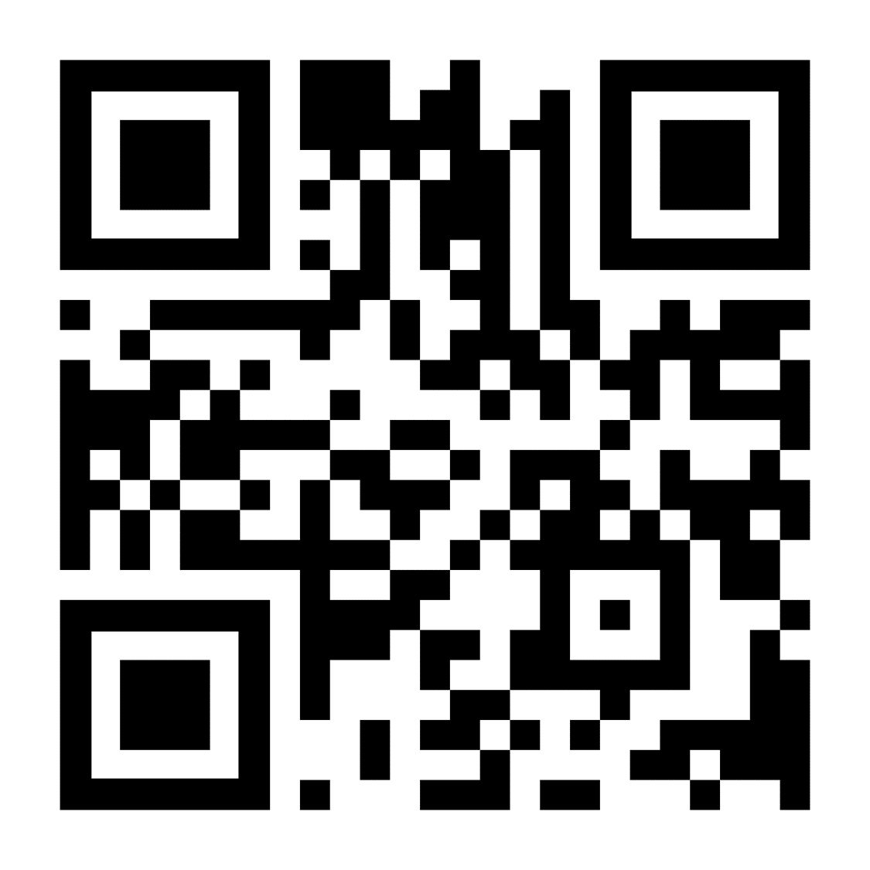

German Funding Programmes
BAYLAT-Call for Proposals for New Scientific Projects
(BAYLAT-Anschubfinanzierung)
Next call
second half of 2024
Aim: creating new and long-lasting scientific cooperation between Bavarian and Latin American partner institutions
Eligibility:
  collaborative projects of investigation
  design of joint study programs
  collaborative projects aiming at the improvement of lectureship
Yearly call for proposals
Funding of up to 8,000 € per proposal
Also includes travel costs to Bavaria and accommodation for Latin American partners
Open for all disciplines and themes and 20 countries in Latin America
baylat.org

Slide 23
German Funding Programmes
FAPESP/BAYLAT-Workshop
Next call
probably 2025
Aim: increase and expansion of cooperation in science and research between the partner regions Bavaria and the State of São Paulo including funding of junior researchers
Eligibility: Scientific workshops, mobility of scientists, information exchange
Yearly call for proposals
Workshops take place in Bavaria and in the State of São Paulo
Funding: approx. 25,000 EUR for each side
Open for all disciplines and themes and researchers from the two regions
baylat.org

Slide 24
German Funding Programmes
Scholarships for students
Scholarships for students at Latin American Universities
Funds Latin American students for a research stay at a partner institution in Bavaria
Amount: 934 € per month + 200 € (one-off payment for health insurance)
Funding period: 1 - 5 months
Criteria: grades, quality and practicability of research stay, language skills level
No funding for PhD candidates
Mobility scholarships for Bavarian students to Latin America
Mobility grants for: study abroad for academic research, thesis writing (Bachelor's, Master's, or admission thesis), or internship stay in Latin America
Amount: up to 1,500 €
Last call is being evaluated
Next call
2025
baylat.org

Slide 25

German Funding Programmes
German Federation of Industrial Research Associations
Federação Alemã de Associações de Pesquisa Industrial

Slide 26
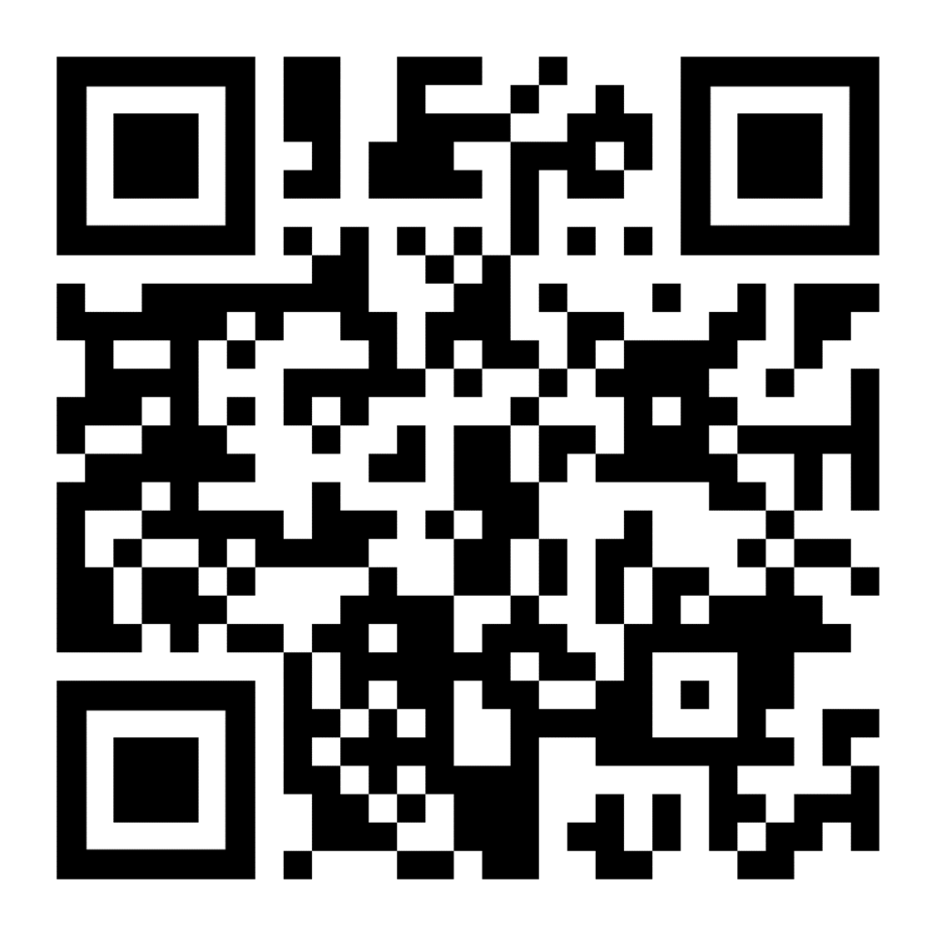

German Funding Programmes
International Network IraSME
Network of ministries and funding agencies
Synchronized national funding for transnational R&D projects
National / regional funding conditions are binding
Two calls for proposals per year
Deadlines end of March and September
34th call: until 25th September 2024
Documents: IraSME proposal application form + national application form
Brazilian partner: EMBRAPII
Other funding sources in Brazil accepted
ira-sme.net/countries-regions

Slide 27
German Funding Programmes
International Network IraSME
Project Requirements
Development of new or significant improvement of existing products, processes and technical services
Bottom-up approach
Up to prototype level (TRL 4-7)
Significant technical risks for each partner
High market potential
Typical IraSME Project
2-6 participants – clearly distinct subprojects for each partner
2 SMEs / 2 participating countries / regions
RTOs as additional partners or subcontractors (e.g. For EMBRAPII Brazil!)
Felix Rotter
info@ira-sme.net
ira-sme.net/countries-regions

Slide 28

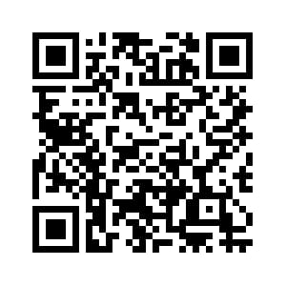


Stay in touch
Newsletter
dwih-saopaulo.org
DWIH São Paulo
DWIH São Paulo

Slide 29
Thank You!
German Centre for Research and Innovation (DWIH) São Paulo
Centro Alemão de Ciência e Inovação (DWIH) São Paulo
Rua Verbo Divino, 1488, Térreo
04719-904 – São Paulo – SP
info.saopaulo@dwih.org
+55 11 5189-8300

