Slide 1

Cover
Sven Dinklage
Liaison Office – Campinas/SP
dinklage@uni-potsdam.de

Slide 2
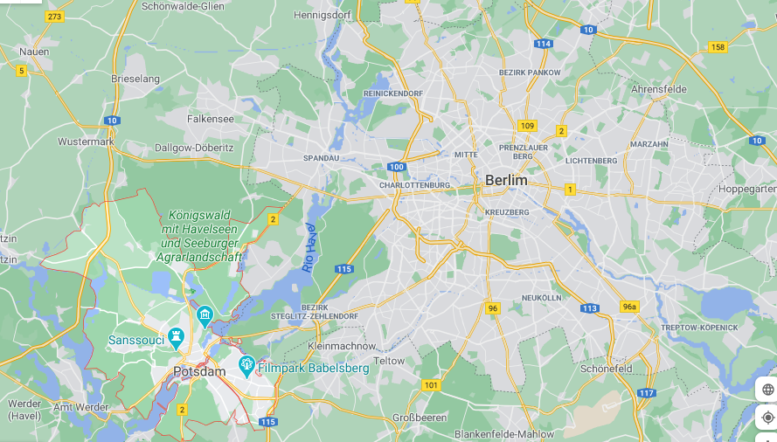

Slide 3
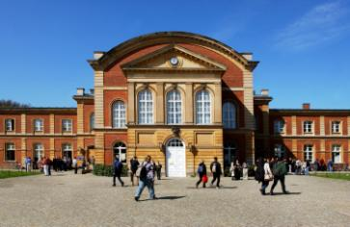
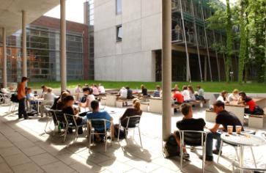
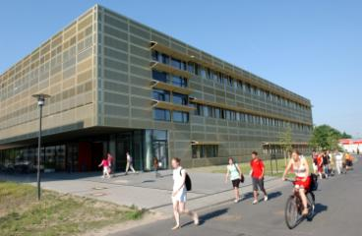
UP Facts
UP Facts and Figures
Founded in 1991
Three campuses, 7 faculties
Total no. of professors: 359 (83 jointly appointed)
Approx. 21,500 students
>56% female students
ZeLB – Center for Teacher Training and Education Research
Unique courses:
- Jewish Theology
- War Studies / Military History
- Cognitive Sciences (with Babylab)
- Public Policy and Management
- Cyber-Security, Data Engineering
- …

Slide 4























Cooperating Non-university Research Institutions
Comunidade Científica Gottfried Wilhelm Leibniz (Associação Leibniz)
Associação Helmholtz de Centros de Pesquisas Alemãs
The „Fraunhofer-Gesellschaft“ | v
Max-Planck-Society
Institutions of the Federal Ministry of Economics and Technology (BMWi)
Institutions in Berlin & Brandenburg

Slide 5
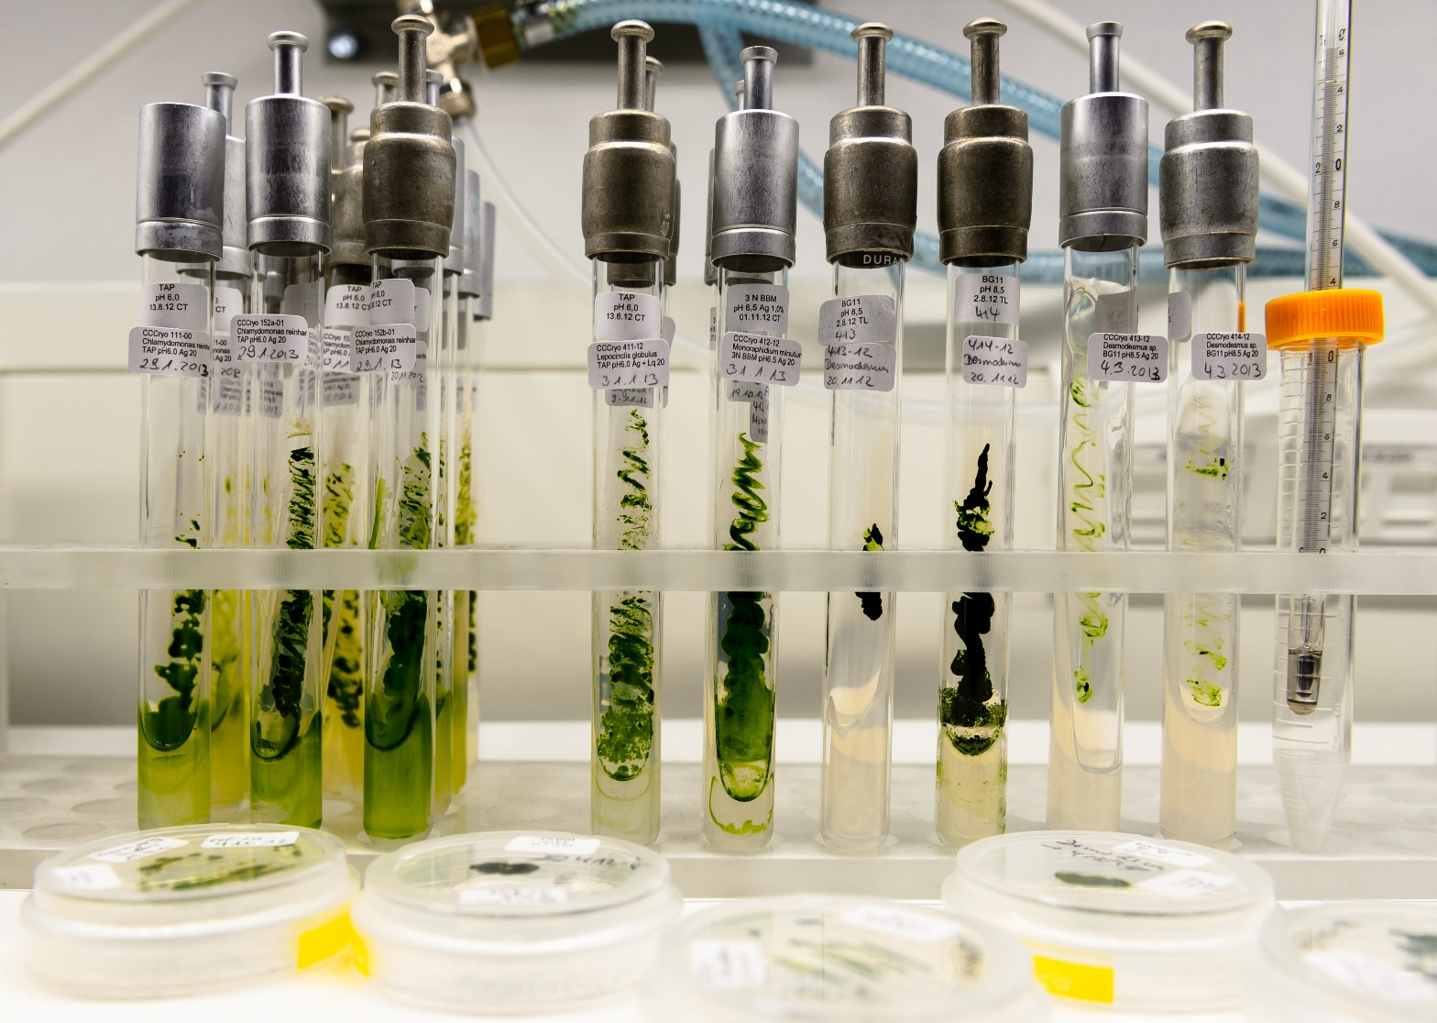
Research
Research focuses
Research
Earth and Environmental Systems
Data-Centric Sciences
Evolutionary Systems Biology
Cognitive Sciences

Slide 6
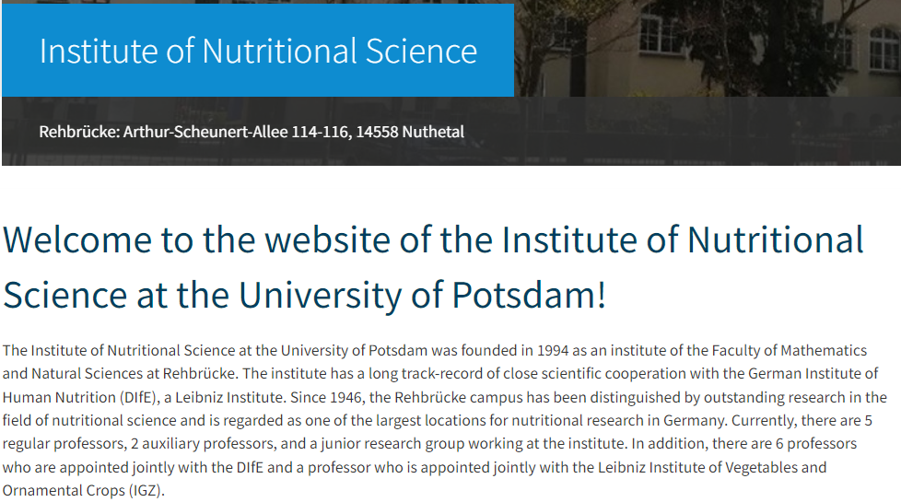
Nutritional Science
https://www.uni-potsdam.de/en/iew/
University of Potsdam – Where Knowledge Grows

Slide 7

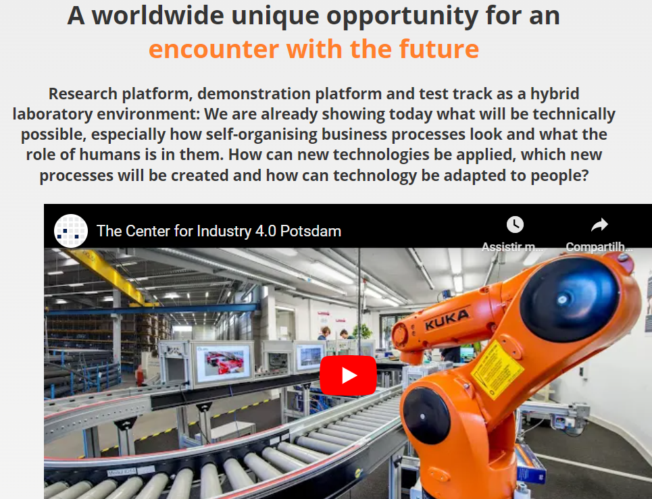
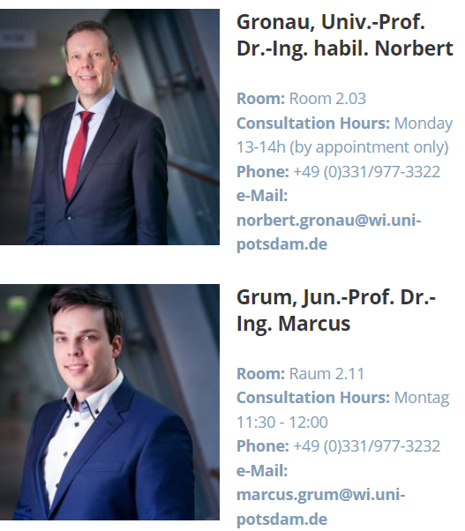
Chair of Business Informatics, Processes and Systems
https://lswi.de/?lang=en
University of Potsdam – Where Knowledge Grows

Slide 8
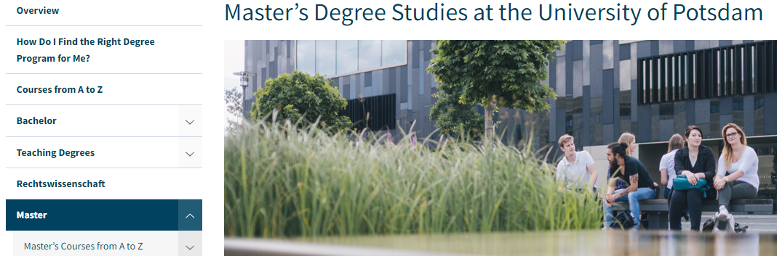
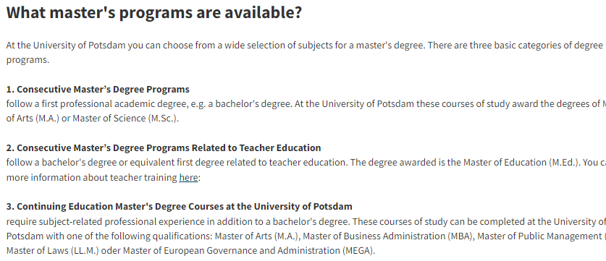
Programas de Master na Uni Potsdam
https://www.uni-potsdam.de/en/studium/what-to-study/master
University of Potsdam – Where Knowledge Grows

Slide 9
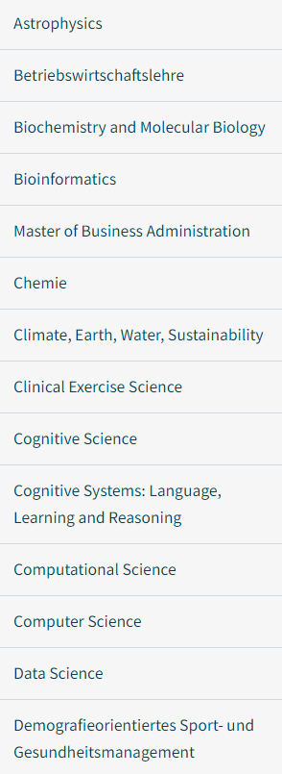
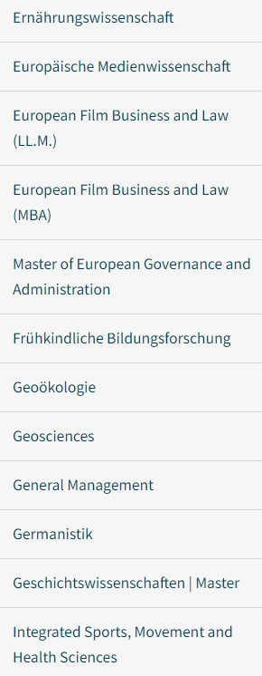
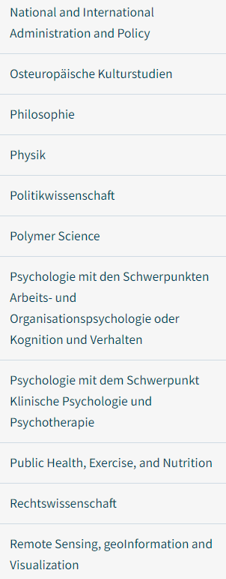
Master Programs relacionados
https://www.uni-potsdam.de/en/studium/what-to-study/master
University of Potsdam – Where Knowledge Grows

Slide 10
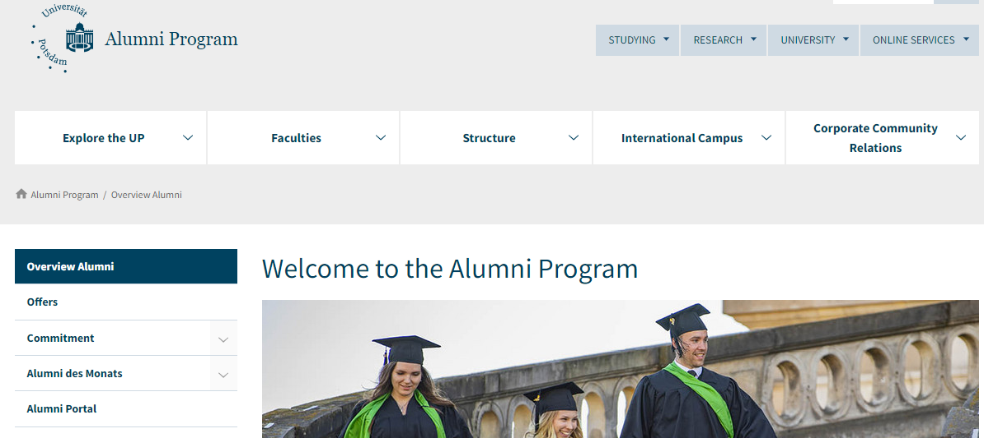
Research Alumni Network (1)
University of Potsdam – Where Knowledge Grows

Slide 11
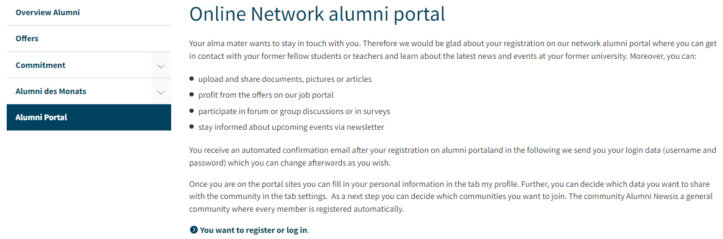
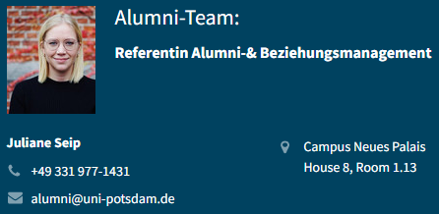
Research Alumni Network (2)
NOVO/NEU:
Alumni Return Grant
https://www.uni-potsdam.de/en/alumni/alumni-portal
University of Potsdam – Where Knowledge Grows

Slide 12

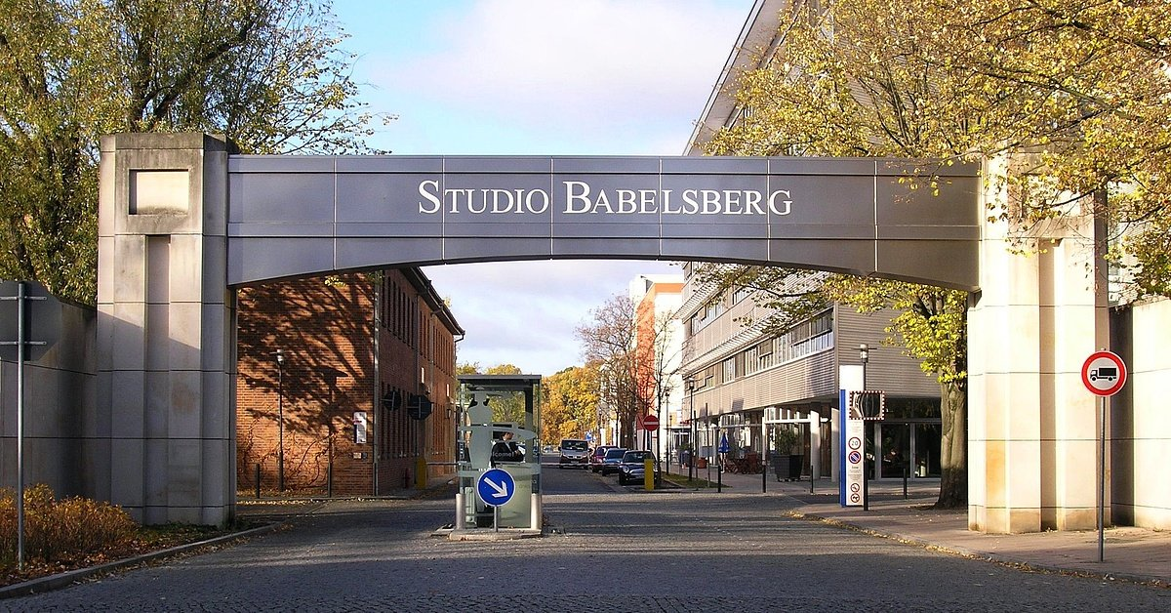

Slide 13




Centro de Cinema: Potsdam-Babelsberg

Slide 14
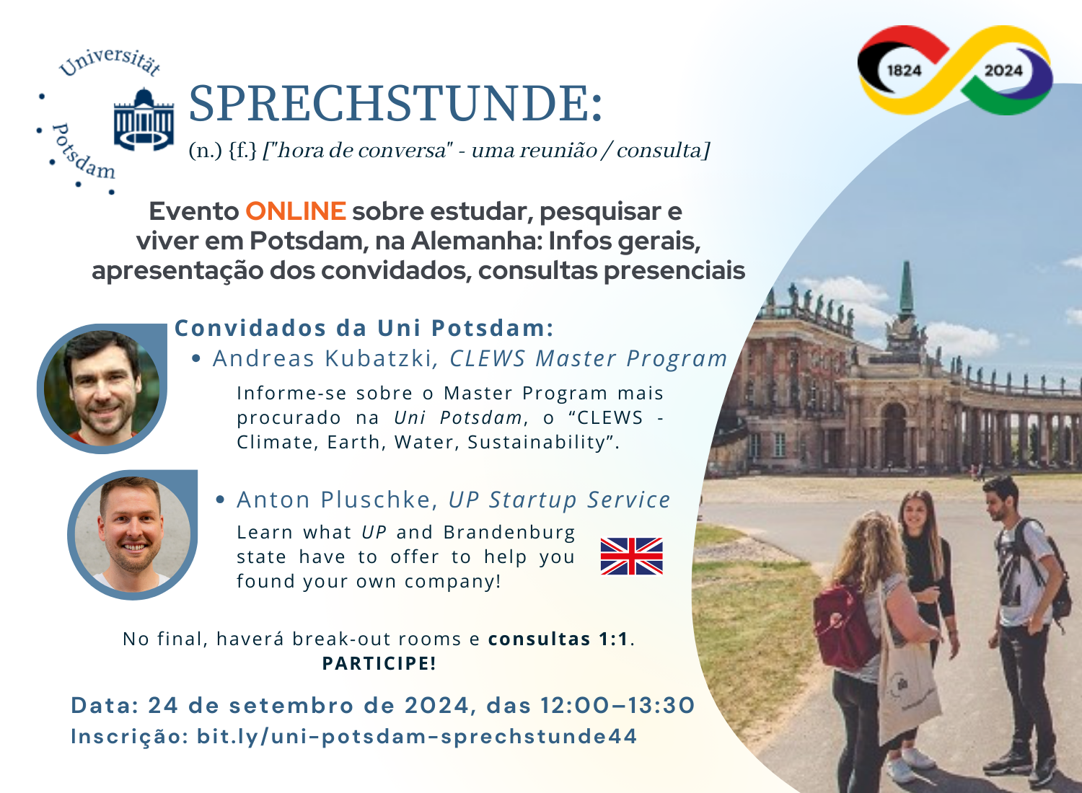
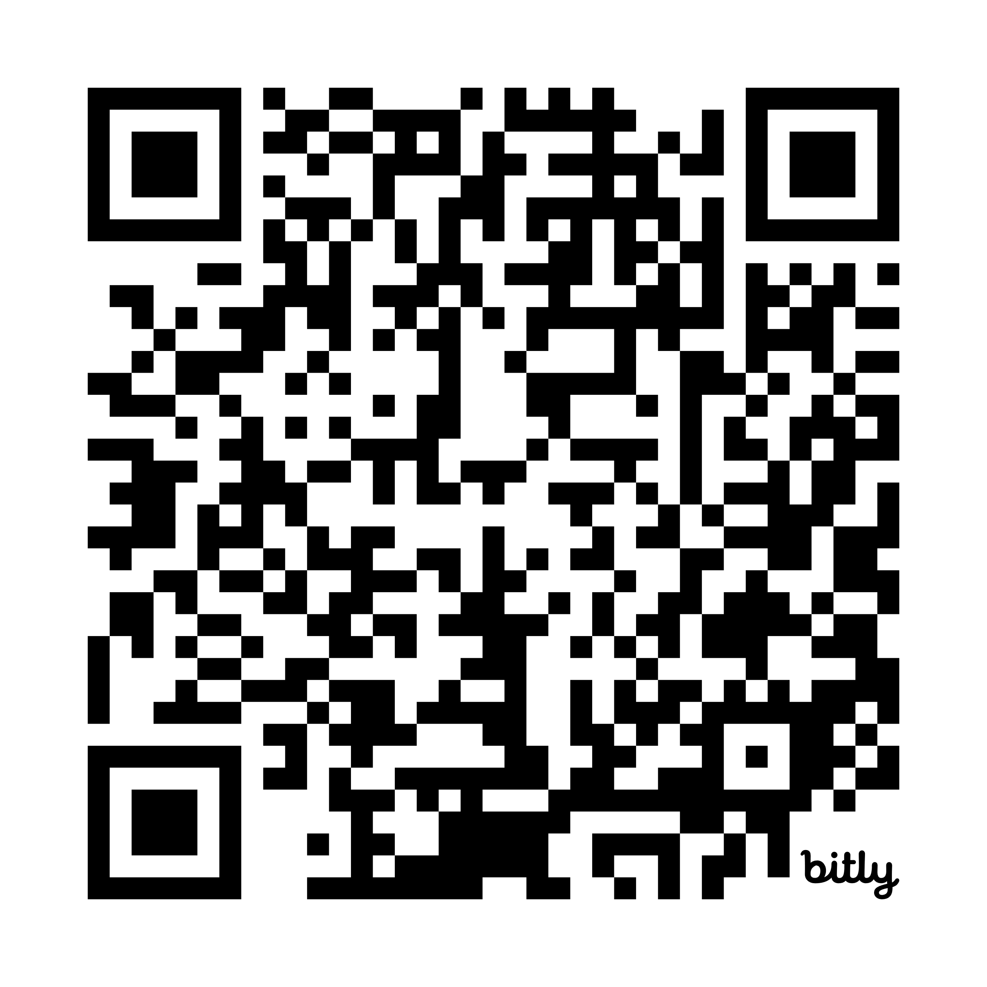
Nossa próxima “Sprechstunde“
bit.ly/uni-potsdam-sprechstunde44

Slide 15


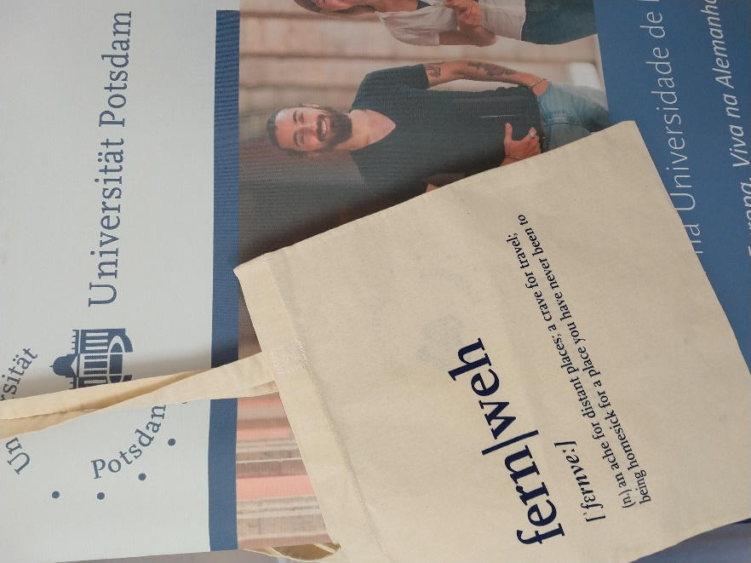
University of Potsdam – Where Knowledge Grows

Slide 16
Centro de Cinema: Potsdam-Babelsberg

Slide 17

Quellen
OBRIGADO, E MUITO SUCESSO!!!
Contato: dinklage@uni-potsdam.de
University of Potsdam

