Slide 1
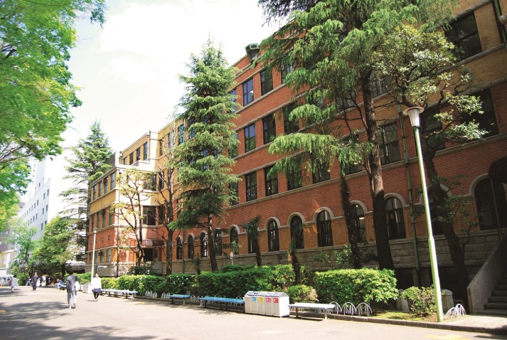
Sophia University
“Bringing the World Together”
A University with Global Mission
Tokyo, Japan

Slide 2
Sophia Overview 1/2
Japanese name: “Jochi Daigaku” （上智大学）
Sophia University was founded by Jesuits in 1913: mission to establish bridges between Japan and the world
Located in the heart of Tokyo
Pioneer in International Education in Japan
Notes:
First, please let me explain the overview of our university.
The name of our university is “Sophia University” in English, and we are called “ Jochi Daigaku” in Japanese.
“Sophia” is a Greek word, and it means the highest wisdom.
Our university was founded by the Jesuits in 1913, more than a hundred years ago from now in the center of Tokyo. It began with the mission to build bridges between Japan and the world.
The Sophia campus is a microcosm of global society with students coming from more than 80 countries. Almost all the faculties and graduate schools are located in the Yotsuya campus.
Sophia has been a pioneer of international education in Japan, attracting faculty and students from all over the world. We were selected as one of the leading universities for internationalization of universities in Japan – so called “Top-Global” universities.
※外国人学生の国籍が84ヶ国（2023大学案内）なので、with students coming from more than 80 countriesとした

Slide 3
Sophia Overview 2/2
In 1949 we established Japan’s first program taught entirely in English.
We continue to lead Japanese academic world in offering international programs:
Worldwide Network with 400 Partner Universities from 83 Countries (as oｆ May 2023)
Educational philosophy of
the Society of Jesus
“For Others, with Others”
3
Notes:
In 1949 Sophia established the first program in Japan taught entirely in English, and it continues to lead the Japanese academic world in offering international programs.
As of today, we have worldwide network with 400 partner universities from 83 countries. （※協定校数、国数修正）
Our university is known for its international atmosphere, excellent language programs, and outstanding research programs.
Now we have full-degree programs taught in English at Faculty of Liberal Arts, Faculty of Science and Technology, MS/Ph. D. programs in Green Science and Engineering, MA/Ph. D. programs in Global Studies and Global Environmental Studies, and MA in TESOL program. We newly launched SPSF (Sophia Program for Sustainable Futures) in 2020.It offers bachelor‘s degrees in seven fields of study: journalism, education, sociology, economics, management, international relations, and area studies. （※SPSFの説明追加）
FLA (Faculty of Liberal Arts ) has more than 60 years of experience, and Graduate Program in Global Studies are more than 30 years old.
Sophia University is famous especially for foreign-language-education and internationality, as we offer students a variety of study- abroad programs, such as exchange program and many kind of short-term study abroad programs.
We shares the educational philosophy of the Society of Jesus, “For Others, with Others”.
As a Jesuit university, we attach importance on the whole person education, and our students are challenged to engage in the world, especially the most vulnerable and disadvantaged members of the global community.

Slide 4
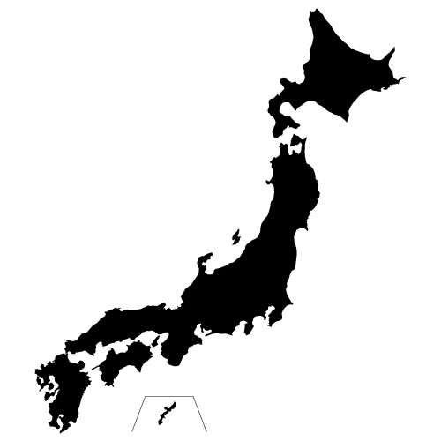

Our Location
Perfect location
for study and research!
The area has long been at center of Japanese political, economic, and cultural scenes.
Walking distance：
Imperial Palace, National Diet,
National Theater, etc.
5 to 10-minute train ride:
Shinjuku, Akihabara,
Shibuya, Roppongi
●TOKYO
●SOPHIA
4
Notes:
As mentioned earlier, our university is located in the heart of Tokyo.
The area around the university has long been at the center of the Japanese political, economic and cultural worlds.
The Imperial Palace, the National Diet, the State Guest House, and the National Diet Library as well as an array of offices of multinational enterprises are all within easy walking distance of the university.
Also, it takes only 5 to 10-minutes train ride to other large stations such as Shinjuku, Akihabara, Shibuya and Roppongi etc.
It is a place where you can feel the dynamism of the global city Tokyo, experience its urban atmosphere and keep up on the trends of the times.

Slide 5
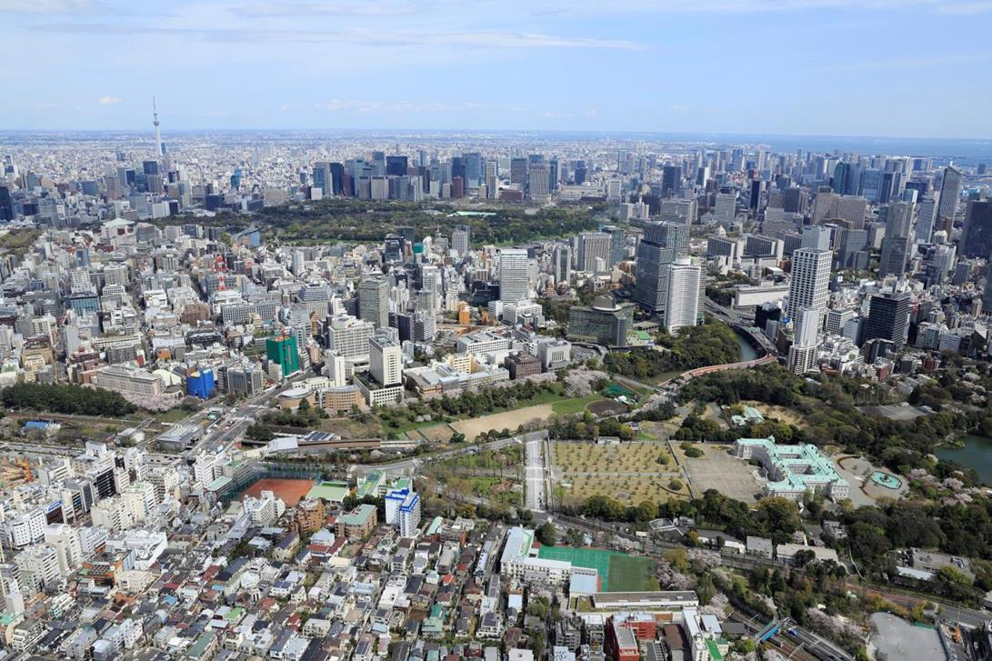
Our Campus
Tokyo Sky Tree
Tokyo Sta.
Imperial Palace
SOPHIA UNIVERSITY
Yotsuya Sta.
Guesthouse for national guests
Notes:
This is the picture of our entire campus in Yotsuya.

Slide 6
Facts and Figures as of 2022
Number of Students
13,498 ( May 2022)
Undergraduate: 12,080 Graduate:1,418
Students/
Faculty Ratio
25:1
Small class sizes, Interactive programs
Academic
Calendar
2 Semesters (Spring/Fall)
Spring: April-July, Fall: September-January
※4 quarters (Q1～Q4)
6
Notes:
Sophia is a middle size university as you can tell from this slide.
As of May 2022, our total student number is about 13,000. (※2022年統計データより）
The student to faculty ratio is 25 to 1. The class sizes are small and students can get more personal attention. Also, it’s possible for students to take classes from different departments and faculties, so they will have a lot of chances to interact with one another.
We have 2 semesters a year. Our academic year begins in Spring semester, from April 1 to the end of July. The second semester begins in late September and ends in the end of January.
At the same time, we also have quarter system. We divide Spring semester into Q1 and Q2, Autumn semester into Q3 and Q4.
（※クォーター追加）

Slide 7
International Students/Faculty (2019)
1873 International Students
from 88 Countries
China (46％)
South Korea (12%)
USA (11%)
Europe (11%)
70% of International Students, from 19 countries in Asia
15% of full-time faculty members from overseas
7
Notes:
Every year, many international students come from all over the world to study at Sophia.
As of May 2019, there are 1873 international students studying here.
Many of them come from Asia, but we also have a large number of students coming from North America and Europe.
Also, among the faculty members, about 15 percent of them are from various countries other than Japan.
Moreover, not only international students, but also local students are diverse in their backgrounds. Quite a number of them grew up overseas or have experienced living abroad. This fact contributes to create Sophia’s atmosphere of cross-cultural understanding.
※最近はコロナ禍で数が少ないので、2019年度版の数を使用

Slide 8
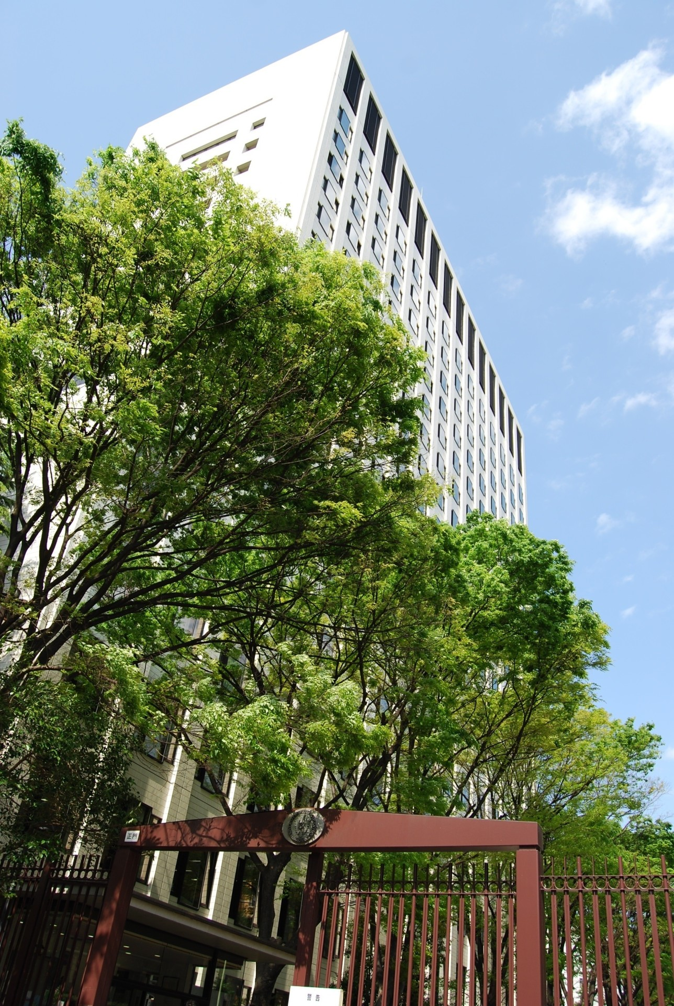
Academic Programs - Undergraduate
9 Undergraduate Faculties, 29 Departments
1. Theology
2. Humanities
3. Human Sciences
4. Law
5. Economics
6. Foreign Studies
7. Global Studies (since 2014)
8. Liberal Arts ＊
9. Science & Technology
Green Science ＊
Green Engineering ＊
＊＝English-based programs
8
Notes:
I will now explain what kind of programs and courses are offered at Sophia.
As of today, Sophia University has 9 undergraduate faculties with 29 departments.
In Faculty of Humanities, we have department of philosophy, history, Japanese Literature, English literature, German Literature, French literature and Journalism.
In Faculty of Human Sciences, we have department of education, psychology, sociology, social services, and nursing.
In Faculty of Law, there are department of law, international legal studies and legal studies of the global environment.
In Faculty of Economics, we have both department of economics and management.
In Faculty of Foreign Studies, there are English studies, German studies, French studies, Hispanic studies, Luso-Brazilian studies, and Russian studies.
In Faculty of Global Studies is designed to develop young professionals who can become the leader of the global world,and find solutions in any situations by viewing from both global and local perspectives.
Faculty of Liberal Arts, in red on the screen, are completely taught in English in all classes.
This Faculty offers degree programs in Comparative Culture, International Business and Economics, and Social Studies.
A large portion of the International students enroll in this faculty.
FLA prepares students with an international background to participate actively in international contexts and organizations. The Faculty’s academic programs are designed to equip graduates with the intellectual knowledge, linguistic abilities, and cultural skills necessary to take the lead in bridging differences and promoting understanding in today’s increasingly multicultural and international world.
At Sophia, every year we receive more than 300 exchange students from all over the world, and more than 90% of them are enrolled in the Faculty of Liberal Arts.
The other faculties teach primarily in Japanese, but there has been a steady increase in classes offered in English.
We offer two English-taught programs in Faculty of Science & Technology, Green Science and Green Engineering.
Besides taking academic classes in the faculty, it’s also possible to take a full-range of Japanese language courses for international students offered by Center for Language Education and Research. They provide various levels of Japanese courses from the beginner’s level for people who have never learned Japanese, to advanced level such as translations between English and Japanese.

Slide 9
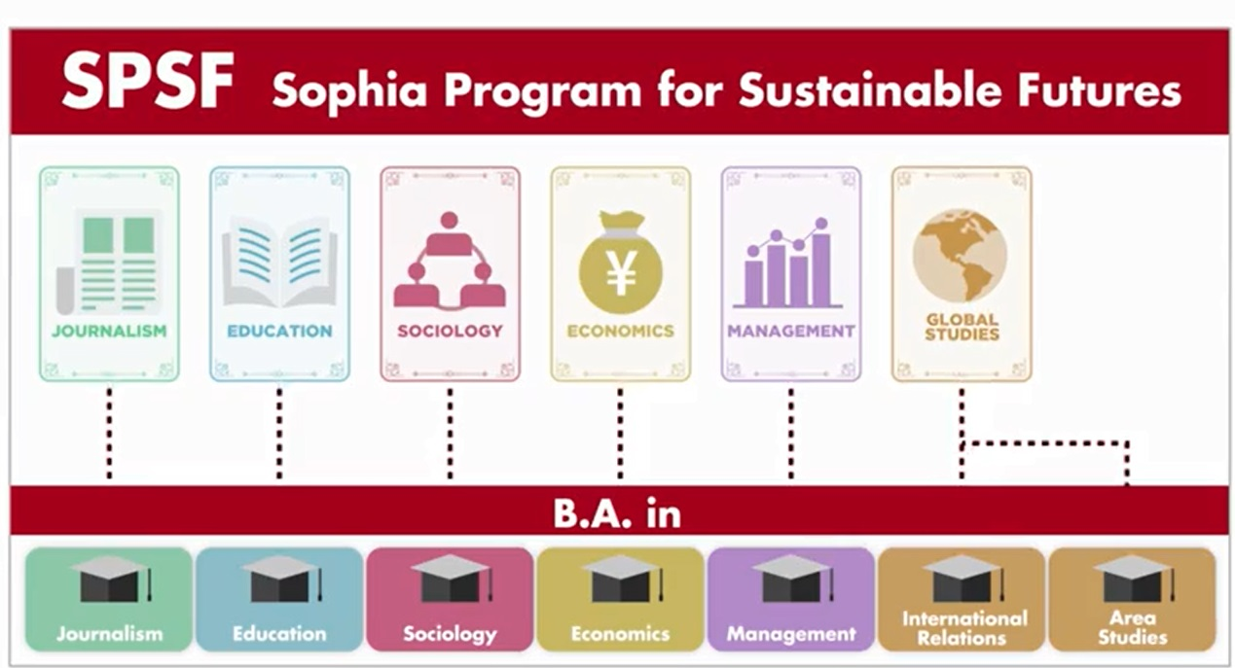
New English-taught Undergraduate Program
(from Autumn 2020)
Notes:
Also, starting from Autumn semester 2020, our university has started to provide the New English-taught undergraduate program called Sophia Program for Sustainable Futures.
This program includes six fields, journalism, education, sociology, economics, management, and global studies.
And degree seeking students will be able to receive the Bachelor of Arts degree in each field.
After this program is launched, we expect that the numbers of our English-taught courses will be increased largely, and more international students, both degree and non-degree students will come to Sophia.

Slide 10
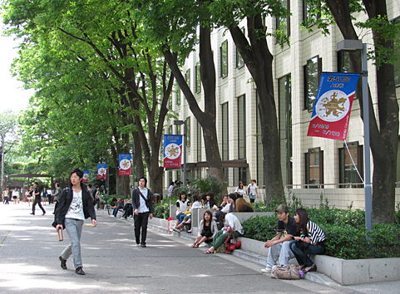
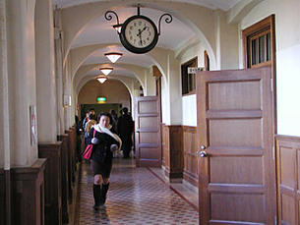
Academic Programs - Graduate
10 Graduate Schools, 25 Programs
1. Theology
2. Applied Religious Studies
3. Humanities
4. Human Sciences
5. Law
6. Economics
7. Language and Linguistics (TESOL Program＊)
8. Global Studies＊
9. Science & Technology
Green Science and Engineering ＊
10. Global Environmental Studies＊
＊＝English-based programs
10
Notes:
Next let me briefly introduce you about our graduate programs. Currently we have 10 graduate schools with 25 programs.
At the graduate level, Sophia offers more classes taught in English than other Japanese universities.
The programs in red offer courses taught in English: TESOL (Teachers of English to Speakers of Other Languages) Program in Graduate School of Foreign Studies, and Graduate Program in Global Studies, Green Science and Engineering in Graduate School of Science & Technology, and Global Environmental Studies Program.
Graduate Program in Global Studies has the longest history as an English taught graduate program at Sophia starting in 1979, and it has a large number of international students. It offers master's degrees in Global Studies, International Business and Development Studies, and Japanese Studies, and Ph.D in Global Studies and Japanese Studies. This is considered as the graduate program for Faculty of Liberal Arts.
And since September 2013, the Graduate School of Science and Technology has also begun to offer an English-taught graduate program in Green Science and Engineering Division.
In Graduate Program in Global Environmental Studies, the curriculum combines social and natural sciences, in recognition of the fact that effective environmental study spans a number of scholastic disciplines, including law, policy, administration, economics, population, energy and chemistry. The school is devoted to creating graduates equipped to serve effectively as business persons, specialists or scholars in the area of environmental protection.

Slide 11
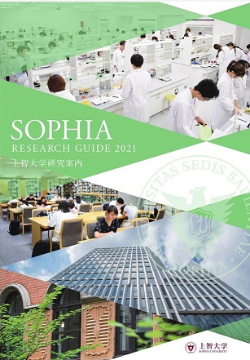
Sophia Research Organization
12 Research Institutes
3 Project Research Divisions
11 Affiliated Research Institutes
Please visit our website for more details
on Sophia Research Activities:
https://www.sophia.ac.jp/eng/research/index.html
11

Slide 12
Sophia Research Organization
12 Research Institutes Division
1. Institute for Christian Culture
2. Institute of Medieval Thought
3. Iberoamerican Institute
4. Linguistic Institute for International Communication
5. Institute of Global Concern
6. Institute of Comparative Culture
7. European Institute
8. Institute of Asian, African, and Middle Eastern Studies
9. Institute of American and Canadian Studies
10. Institute for Studies of the Global Environment
11. Institute of Media, Culture and Journalism
12. Institute of Islamic Area Studies
12

Slide 13
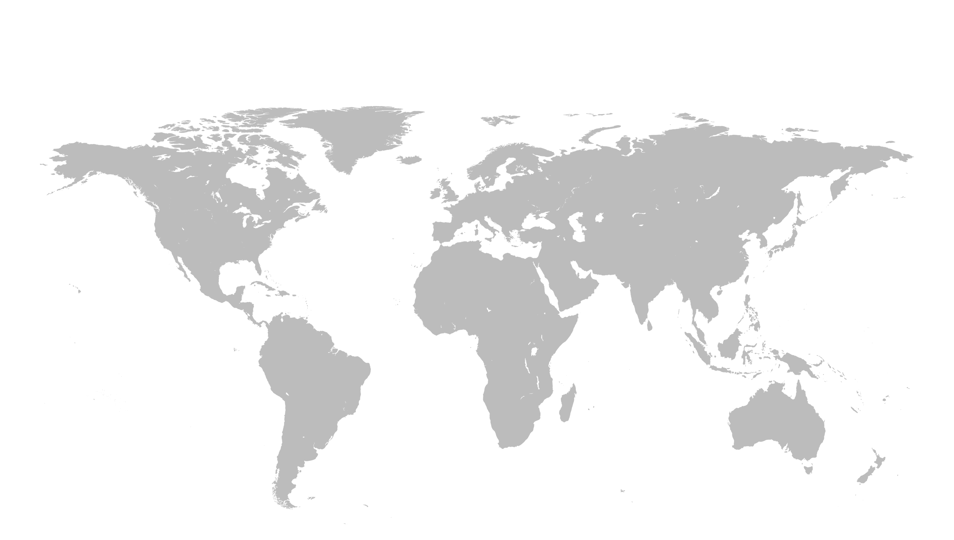
Worldwide Partner Institutions
400 partner institutions from 83 countries
(As of May 2023)
Europe
University of Edinburgh
Institut d'Etudes Politiques de Paris
Universität Heidelberg
Università di Roma "La Sapienza"
Leiden University
Moscow State University
North America
Boston College
Georgetown University
University of California, Berkeley
University of British Columbia
Latin America
Pontificia Universidad Católica de Chile
Universidade de São Paulo
National Autonomous University of Mexico
Asia
Tsinghua University
Fudan University
The University of Hong Kong
Yonsei University
Ateneo de Manila University
Chulalongkorn University
Oceania
The University of Melbourne
The University of Queensland
The University of Auckland
13
Notes:
Regarding our worldwide partner institutions, Sophia University has started the exchange of faculties and students with worldwide partners since 70 years ago. As of today, we have 400 partner institutions from 83 countries.
These are the list of some of our partners from each region. And we continue to explore more partners for collaboration.
You can find the details of our partnership institution list on our brochure.

Slide 14
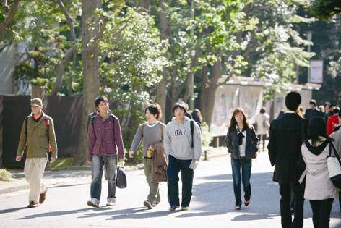
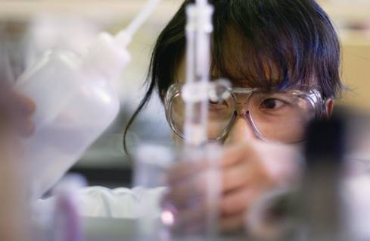
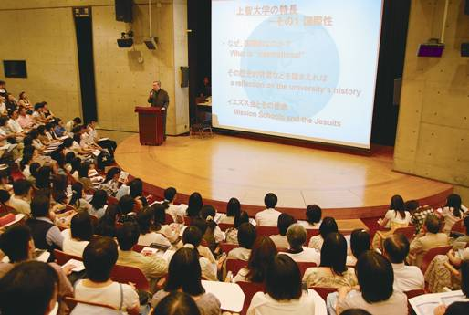
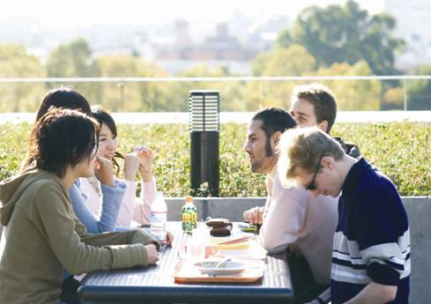
Campus Life
14
Notes:
These are some photos about our student’s campus life.

Slide 15
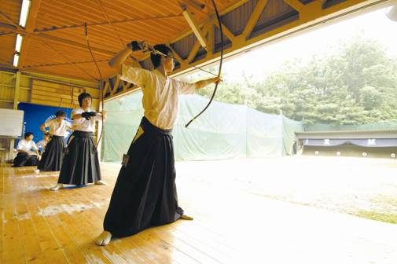
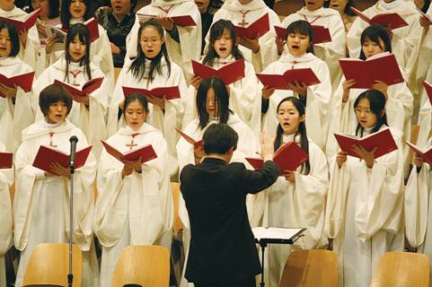
Club Activities
Athletic Clubs
Japanese Archery, Judo,
Tennis, Golf, Ski,
Soccer…
Music Clubs
Orchestra, Guitar, Jazz,
Chorus…
Volunteer Clubs
and so on…
Over 260 clubs
15
Notes:
There are more than 260 clubs and circles that students can participate. Most of them also welcome international students.
2022大学案内の数字より

Slide 16
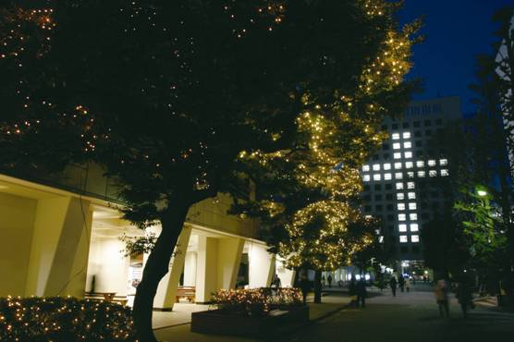

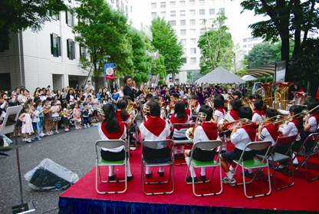
Seasonal Events
Sophia Festival
…MR & MS Sophia
Contest,
Performances
Sports Festival
Music Festival
Welcome Party
Christmas Event
1 Day-Trip
etc…
16
Notes:
During the one academic year, we have various events in different seasons.
The Sophia Festival is held in November every year, and Mr.& Ms. Sophia Contest and performances are held in the festival.
When the Christmas season approaches, we will have lighting-up on campus.

Slide 17
Sophia Bringing the World Together

